Slide 1
M8H (2025) Ch1
Lesson 7
Prime Factorization
Number of Factors
© Copyright all rights reserved to Homework depot: www.BCMath.ca

Slide 2
What is a Prime Factorization:
The prime factorization of a number is writing a number as a product of all it’s prime in powers
When a number is written as in “Prime Factorization” form, it allows you to find the following:
i) How many factors there are
ii) How many perfect square factors
iii) How many factors that are ODD numbers
iv) How many factors that are EVEN numbers
v) The SUM of all your factors

Slide 3
How to Find the Prime Factorization?
To find the prime factorization of a number, keep dividing by it’s factors until all the factors left are prime numbers
Make SURE that all the bases are PRIMES!! If Not, then decompose them!!
Biggest Mistake: Keeping track of your factors such that you don’t miss any or double count them!!! [SO Stay ORGANIZED!!]
Note: All the bases in the Prime Factorization must be prime numbers!
The exponents tell you how many of those prime bases it has

Slide 4
Find the Prime Factorization of each number below:
a) 144 b) 300 c) 968 d) 1924
Which of the following prime factorizations are incorrect? If incorrect, explain why:

Slide 5
Perfect Squares and Cubes:
The prime factorization of a number can be used to tell whether if a number is a perfect square, perfect cube, or neither
If a number is a PS, the exponents of all the prime factors will be “EVEN”
If a number is a Perfect Cube, the exponents of all the prime factors will be a multiple of 3
PERFECT SQUARES:
PERFECT CUBES:
PERFECT
SQ & CUBES:
All the exponents of the prime factors
are multiples of 6
All the exponents of the prime factors
are even!
All the exponents of the prime factors
are multiples of 3

Slide 6
Ex: Indicate if the following numbers are either
i) perfect squares, ii) cubes, iii) neither, or iv) both:
Ex: What is the lowest value of “k”, where “k” is an integer, so that “N” is a
i) perfect square? ii) Perfect Cube

Slide 7
Ex: What is the lowest value of “k”, where “k” is an integer, so that “N” is a i) perfect square? ii) Perfect Cube
To be a perfect square, all the exponents
must be even
Break all numbers down to prime factors
To be a perfect cube, all exponents need
to be a factor of 3
Now, all the exponents are even
So, “k” is equal to
So, “k” is equal to
© Copyright all rights reserved to Homework depot: www.BCMath.ca

Slide 8
Using Prime Factorization to Find GCF and LCM:
When given two numbers in P.F. form, find the GCF by looking at which prime base factors are in both and then pick the lower exponent between the two
Both numbers have 2, 3, and 5 as a prime base:
Looking at the exponents of base 2, we have “2” and “3”, take the lower exponent
Looking at the exponents of base 3, we have “4” and “6”, take the lower exponent
Looking at the exponents of base 5, we have “2” and “1”, take the lower exponent
To find the LCM of two numbers in P.F. form, take all the base prime factors from both numbers, then take the larger exponent between the two

Slide 9
Ex: Find the GCF and LCM between each sets of numbers:
Ex: Given the three numbers, where “a”, “b”, and “c” are prime factors, find the GCF and LCM

Slide 10
Ex: Given the three numbers, where “a”, “b”, and “c” are prime factors, find the GCF and LCM

Slide 11
IV) Finding Number of Factors from Prime Factorization
An efficient to find all the factors of an integer is to use all the different combinations from it’s prime factorization
Each factor will contain part or all of it’s prime factorization
To find the total number of factors, just think of all the different combinations you can create
Here’s the FASTEST way to count the number of factors:
There are 4 numbers in the 1st column
There are 2 numbers in the 2nd column
The total number of factors will then be: 4 times 2 = 8 factors
© Copyright all rights reserved to Homework depot: www.BCMath.ca

Slide 12
V) Finding Number of factors
To find the number of factors, first make sure that you have the prime factorization
Make SURE that all bases are PRIME!!
Take the exponent of each prime factor, add one to each exponent, and then multiply them → gives number of factors
ie: Indicate the number of factors for the following numbers:
© Copyright all rights reserved to Homework depot: www.BCMath.ca

Slide 13
Practice: How many factors does the integer have?
Divide/decompose the number using divisibility rules
Look for all the combinations you can make with these numbers:
Again, here’s the FASTEST way to count the number of factors:
There are 4 numbers in the 1st column
There are 3 numbers in the 2nd column
There are 3 numbers in the 3rd column
The total number of factors will then be:
4 x 3 x 3 = 36 factors

Slide 14
Practice: Find the number of factors for each of the following numbers
Q2: What is the value lowest of “k” such that “N” will have 10 factors?
Q3: What is the smallest number with 12 factors?

Slide 15
Q3: What is the smallest number with 12 factors?
Using the exponents, list all the numbers that can have 12 factors
Now calculate the value of each number:
Subtract 1 from each integer
to get the exponents
Subtract 1 from each integer
to get the exponents
Give the larger exponent to the
smaller prime base
The smallest number with 12 factors is 72
© Copyright all rights reserved to Homework depot: www.BCMath.ca

Slide 16
How Many Factors that are Perfect Squares

Slide 17
How many ODD factors:

Slide 18
How many Factors that are Even:

Slide 19
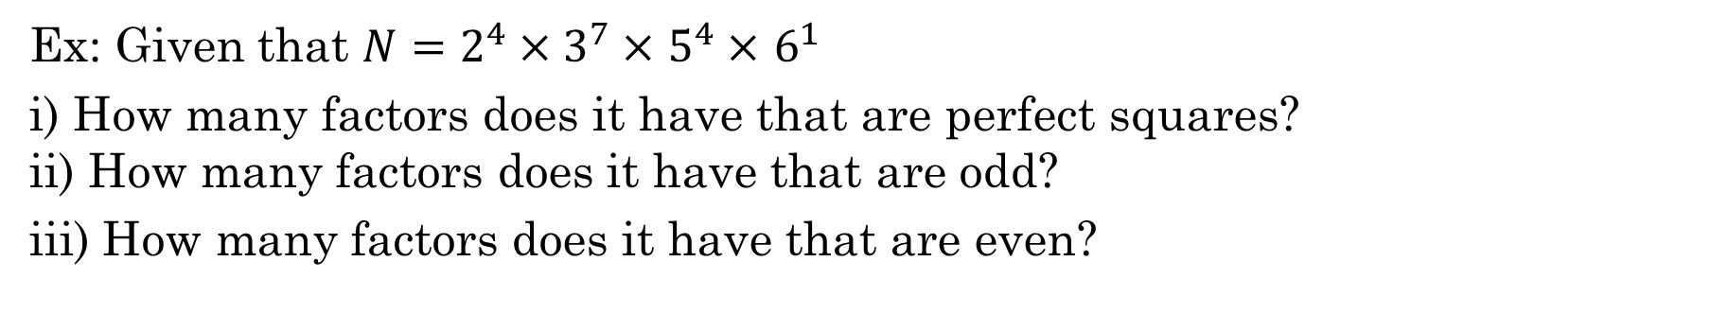
Ex: Given that $N=2^{4}×3^{7}×$ $5^{4}×$ $6^{1}$
i) How many factors does it have that are perfect squares?
ii) How many factors does it have that are odd?
iii) How many factors does it have that are even?

Slide 20
VI) Sum Of all Factors:
To find the sum of all factors, write the number in its prime factorization
Take the power of each prime and find the sum of all its factors
Multiply each sum to get the sum of all factors
© Copyright all rights reserved to Homework depot: www.BCMath.ca

Slide 21
Ex: Find the sum of all the factors for each number
© Copyright all rights reserved to Homework depot: www.BCMath.ca

Slide 22
Faster Way to COUNT the NUMBER of Combinations:
The Fundamental Counting Principle?
If we have “x” number of ways to do the first task and “y” number of ways to do the second task, then there are “x” times “y” ways to do both tasks.
If there are several different tasks:
“A” – Number of ways to do the first task
“B” – Number of ways to do the second task
“C” – Number of ways to do the third task.... and so on
The total number of different ways to do all the task together will be:
© Copyright all rights reserved to Homework depot: www.BCMath.ca

Slide 23



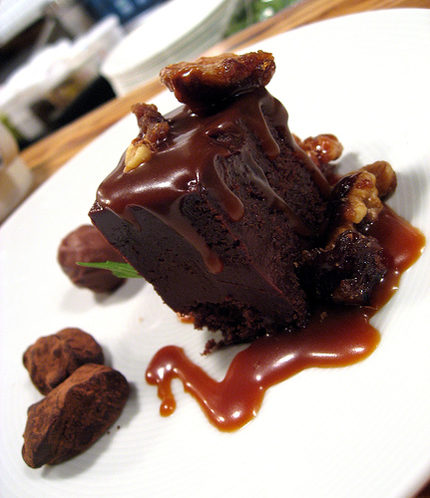
Ex: how many different 3 course meals can you order at the salmon house if there are 3 different appetizers, 4 main course, and 3 different desserts.
There are three different categories: Appetizers, Mains, and Desserts
Use the Fundamental Counting Principles to count how many different
meals are possible
Multiply the number of choices in each
category
© Copyright all rights reserved to Homework depot: www.BCMath.ca

